Slide 1

TRAVEL MANAGEMENT SYSTEM
Submitted by: Sheetal Sambyal(12400399)G1
Isha verma(12400403)G1
Navneet Singh Aloona(12412772)G1
Submitted to : Ms. Ranjit Kaur Walia
UID: 28632
Assistant Professor, SCA, LPU

Slide 2
Table of Content
Sr. No. | Content | Page No.
1 | Introduction
2 | Project Overview
3 | Project Objectives
4 | Problem Statement
5 | Requirement Gathering Interviews and Surveys Website Exploration
6 | ER Diagram and Relational Schema
7 | Database Design and Normalization Tables Description Normalization Process
8 | SQL Queries and Database Operations Create Tables Insert Data Queries for Data Retrieval
9 | Conclusion

Slide 3
Introduction:
The Travel Management System (TMS) is meant to make planning and managing travel easier. In today’s busy world, keeping track of travel information is important for both travelers and travel agencies. A good TMS can help operations run smoothly, enhance the user experience, and provide helpful insights, making it an important tool in the travel industry.

Slide 4
Project Overview:
The TMS aims to offer a complete solution for handling user bookings, travel plans, and preferences. The Key Entities are:
Users : Individuals who book travel services.
Travel Detail: It includes travel id, travel type, source and destination location.
Transport Type: It includes the kind of transportation that user wants to prefer like Flight, Train, Bus or Cab.
Payment: Details of the payment method used for bookings.
Booking: Records of user reservations.
Review: Feedback and ratings provided by users about their travel experiences.

Slide 5
Project Objectives:
User-Friendly Interface: Develop an intuitive platform for easy booking and travel management.
Diverse Transport Options: Support various modes of transportation, such as flights, trains, cabs and buses.
Secure Payment Processing: Ensure safe and convenient payment methods for users.
Accurate Booking Records: Maintain reliable records of user reservations for easy access.
User Feedback System: Implement a review feature to gather ratings and feedback on travel experiences.

Slide 6
Problem Statement:
The current travel management processes are often disjointed, causing problems and inefficiencies. Travelers struggle with managing bookings, travel plans, and personal preferences, resulting in time-consuming operations and lead to mistakes.

Slide 7
Requirement Gathering:
Interviews and Surveys:
Key Findings:
Difficulty in tracking bookings across multiple platforms.
Need for a centralized database for customer information and preferences.
Website Exploration:
Objective: Analyze existing travel management platforms.
Websites Explored: etravelsmart , Omio, Booking.com.
Observations:
User-friendly interfaces.
Diverse Transport Options.
Detailed search options for destinations and travel packages.
Inclusion of user reviews and ratings.

Slide 213
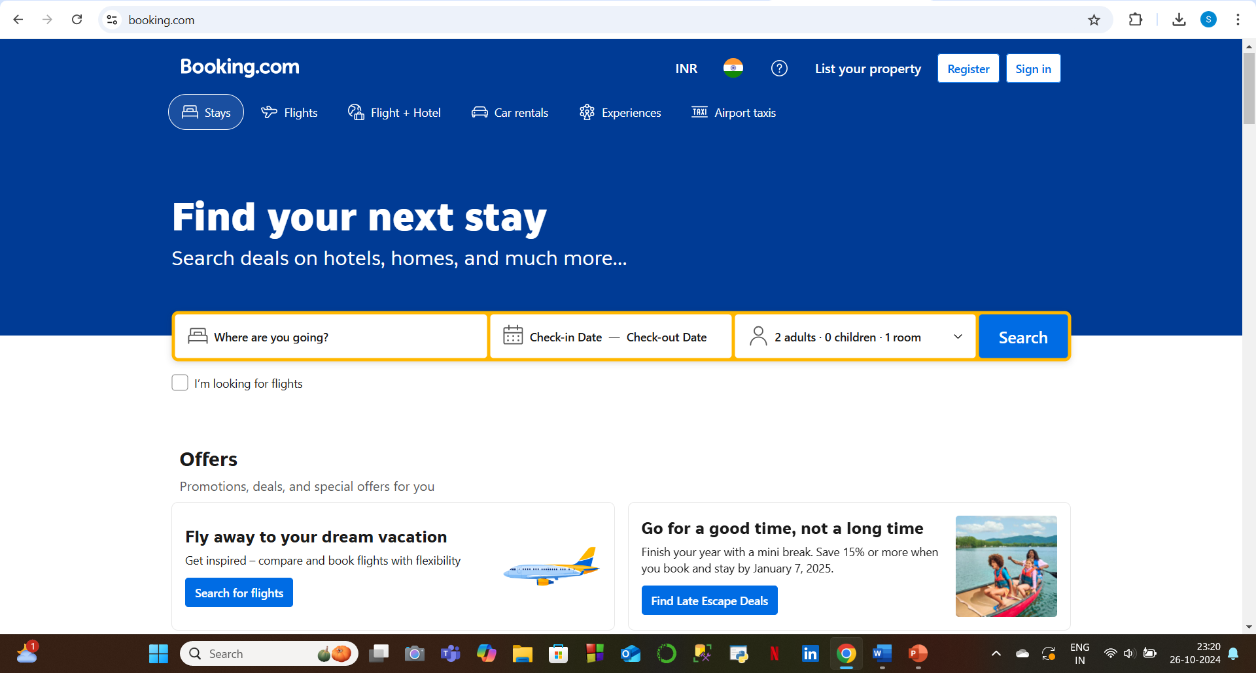

Slide 214
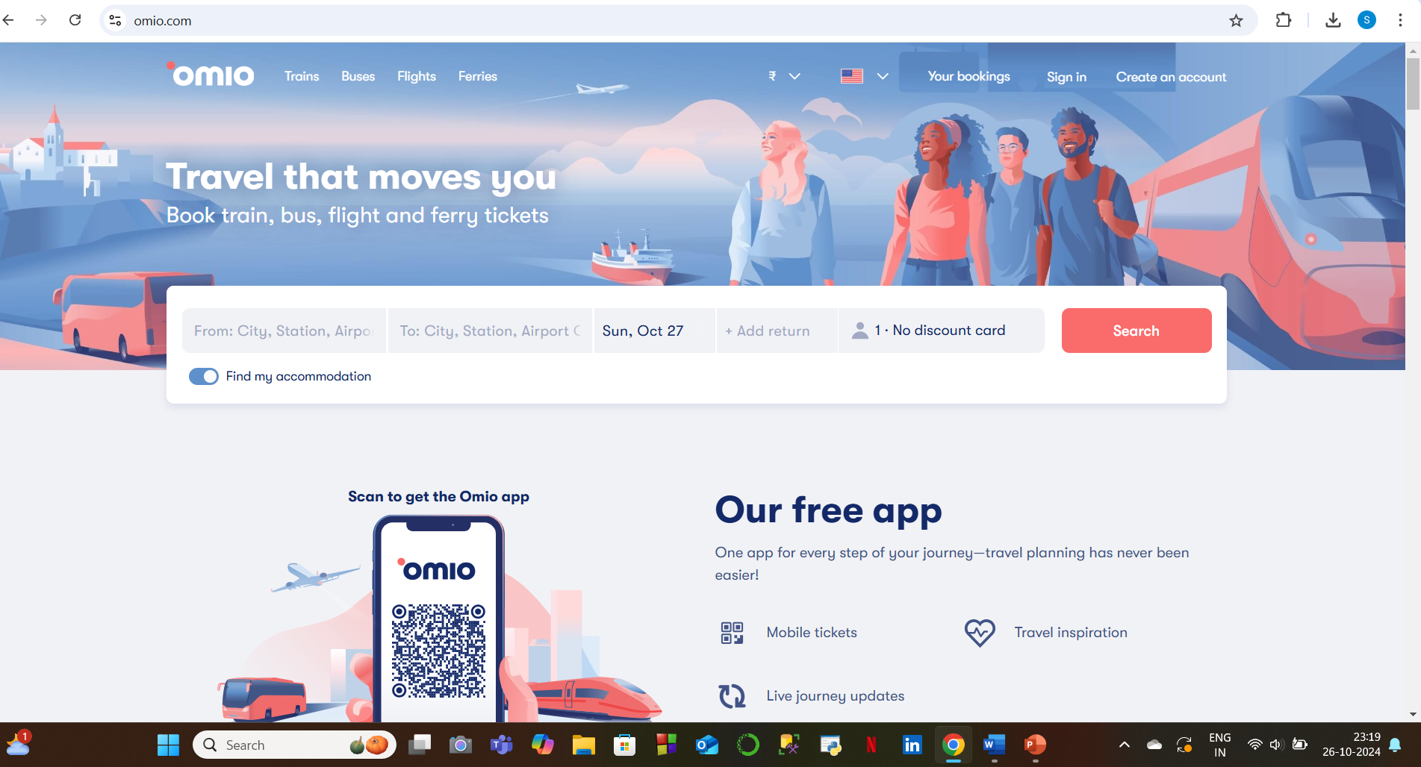

Slide 215
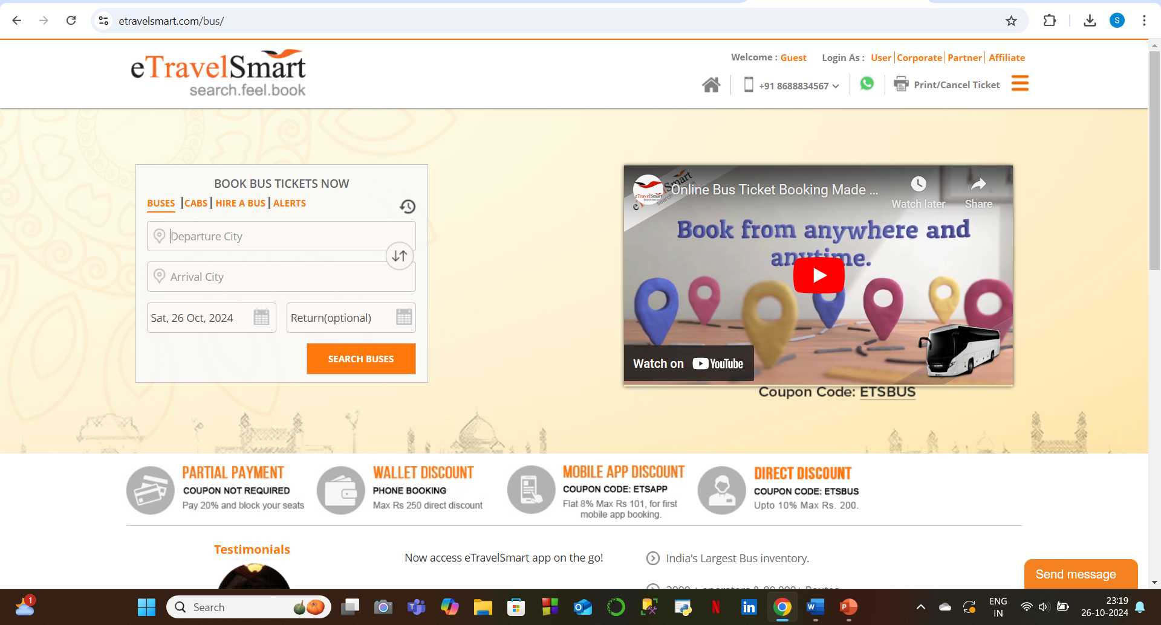

Slide 216
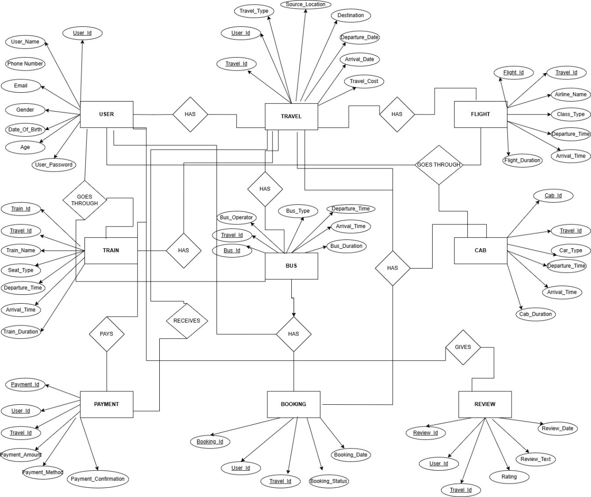
ER Diagram:

Slide 217
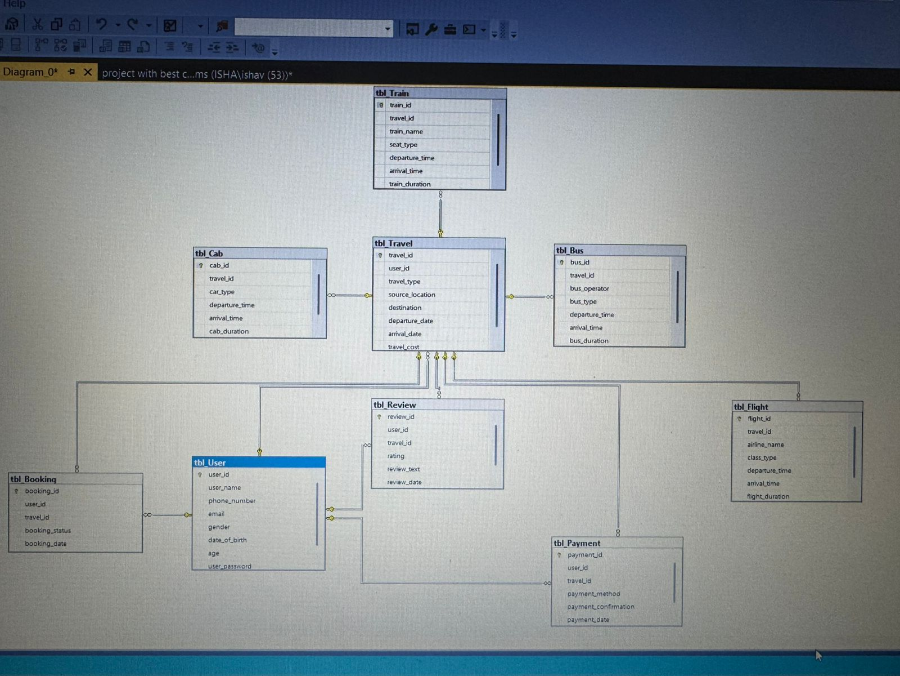
Database Design

Slide 218
Table Description
Table User (tbl_user) Attributes:
user_id (INT): Unique identifier for each user.
user_name (VARCHAR(100)): Name of the user.
phone_number (VARCHAR(15)): User's phone number (unique).
email (VARCHAR(60)): User's email (unique).
gender (CHAR(10)): User's gender (with a check constraint for predefined values: 'male', 'female', 'not prefer’).
date_of_birth (DATE): User's birth date (in ‘yyyy-mm-dd’ format).
age (INT): Age of the user.
user_password (VARCHAR(50)): Password for the user to access the platform.
Primary Key: user_id
Description: This table stores information related to the users of the platform, including their basic details and authentication information.

Slide 219
Table Travel(tbl_travel)
Attributes:
travel_id (INT): Unique identifier for each travel record.
user_id (INT): Foreign key referencing tbl_User(user_id)—the user who made the travel booking.
travel_type (VARCHAR(50)): Type of travel (e.g., flight, train, bus, cab).
source_location (VARCHAR(50)): Departure location.
destination (VARCHAR(50)): Arrival location.
departure_date (DATE): The date and time when the travel begins.
arrival_date (DATE): The date and time when the travel ends
travel_cost (DECIMAL(10, 2)): The cost associated with the travel.
Primary Key: travel_id
Foreign Key: user_id references tbl_User(user_id)
Description: Contains records for all travel-related bookings made by users, with details about travel type, locations, dates, and cost.

Slide 220
Table Flight(tbl_flight)
Attributes:
flight_id (INT): Unique identifier for each flight.
travel_id (INT): Foreign key referencing tbl_Travel(travel_id).
airline_name (VARCHAR(50)): Name of the airline.
class_type (VARCHAR(50)): Class of service (e.g., Economy, Business).
departure_time (TIME): Time of departure.
arrival_time (TIME): Time of arrival.
flight_duration (INT): Duration of the flight in minutes.
Primary Key: flight_id
Foreign Key: travel_id references tbl_Travel(travel_id)
Description: Contains details about flight-related travel, with information such as airline, class, times, and flight duration.

Slide 221
Table Train (tbl_train)
Attributes:
train_id (INT): Unique identifier for each train.
travel_id (INT): Foreign key referencing tbl_Travel(travel_id).
train_name (VARCHAR(50)): Name of the train.
seat_type (VARCHAR(50)): Type of seat (e.g., First Class, Second Class).
departure_time (TIME): Time of departure.
arrival_time (TIME): Time of arrival.
train_duration (INT): Duration of the train journey in minutes.
Primary Key: train_id
Foreign Key: travel_id references tbl_Travel(travel_id)
Description: Stores details about train-related travel, including train names, seat types, departure/arrival times, and duration.

Slide 222
Table Bus(tbl_bus)
Attributes:
bus_id (INT): Unique identifier for each bus.
travel_id (INT): Foreign key referencing tbl_Travel(travel_id).
bus_operator (VARCHAR(50)): Name of the bus operator.
bus_type (VARCHAR(20)): Type of bus (e.g., AC, Non-AC).
departure_time (TIME): Time of departure.
arrival_time (TIME): Time of arrival.
bus_duration (INT): Duration of the bus journey in minutes.
Primary Key: bus_id
Foreign Key: travel_id references tbl_Travel(travel_id)
Description: Contains records of bus-related travel, including bus operators, types, departure/arrival times, and journey duration.

Slide 223
Table Cab(tbl_cab)
Attributes:
cab_id (INT): Unique identifier for each cab ride.
travel_id (INT): Foreign key referencing tbl_Travel(travel_id).
car_type (VARCHAR(50)): Type of the cab (e.g., Sedan, SUV).
departure_time (TIME): Time of departure.
arrival_time (TIME): Time of arrival.
cab_duration (INT): Duration of the cab ride in minutes.
Primary Key: cab_id
Foreign Key: travel_id references tbl_Travel(travel_id)
Description: Contains records for cab-related travel, detailing the car type, departure/arrival times, and duration.

Slide 224
Table Payment(tbl_payment)
Attributes:
payment_id (INT): Unique identifier for each payment.
user_id (INT): Foreign key referencing tbl_User(user_id).
travel_id (INT): Foreign key referencing tbl_Travel(travel_id).
payment_amount (DECIMAL(10, 2)): Amount paid for the travel.
payment_method (VARCHAR(50)): Method of payment (e.g., Credit Card, PayPal).
payment_confirmation (VARCHAR(20)): Payment status (with a check constraint for predefined values: 'confirm', 'pending', 'cancelled’).
Primary Key: payment_id
Foreign Keys: user_id references tbl_User(user_id)
travel_id references tbl_Travel(travel_id)
Description: Stores details about payments made for travel bookings, including payment amount, method, and confirmation status

Slide 225
Table Booking(tbl_booking)
Attributes:
booking_id (INT): Unique identifier for each booking.
user_id (INT): Foreign key referencing tbl_User(user_id).
travel_id (INT): Foreign key referencing tbl_Travel(travel_id).
booking_status (VARCHAR(20)): Status of the booking (with a check constraint for predefined values: 'confirm', 'pending', 'cancelled’).
booking_date (DATE): Date when the booking was made.
Primary Key: booking_id
Foreign Keys:
user_id references tbl_User(user_id)
travel_id references tbl_Travel(travel_id)
Description: Contains information about the booking status and the date of booking for each travel record

Slide 226
Table Review (tbl_review)
Attributes:
review_id (INT): Unique identifier for each review.
user_id (INT): Foreign key referencing tbl_User(user_id).
travel_id (INT): Foreign key referencing tbl_Travel(travel_id).
rating (INT): Rating given by the user (with a check constraint for values between 1 and 5).
review_text (VARCHAR(100)): Text of the user's review.
review_date (DATE): Date when the review was submitted.
Primary Key: review_id
Foreign Keys:
user_id references tbl_User(user_id)
travel_id references tbl_Travel(travel_id)
Description: Stores user reviews for different travel bookings, including ratings, review text, and the date the review was posted

Slide 227
Normalization
First Normal Form (1NF): This form ensures that the table only contains atomic values (no multi-valued or composite attributes).
Table seems to meet 1NF since all columns store atomic values
Second Normal Form (2NF): This form eliminates partial dependencies, meaning every non-key attribute should depend on the whole primary key.
User_id is the Primary Key in tbl_users, and all other attributes depend on user_id, so it satisfies 2NF.
Third Normal Form (3NF): 3NF requires that no transitive dependencies exist. In other words, non-key attributes must depend directly on the primary key and not on other non-key attributes.
(The age is separated into tbl_user_age to eliminate transitive dependency on Date of Birth)
table users
CREATE TABLE tbl_Users (
user_id INT PRIMARY KEY, user_name VARCHAR(100),
phone_number VARCHAR(15) UNIQUE,
email VARCHAR(60) UNIQUE,
gender CHAR(10),
date_of_birth Date ,
user_password VARCHAR(50)
);
--table user age
CREATE TABLE tbl_User_age(
user_id INT foreign key references tbl_users(user_id),
age INT );

Slide 228
Normalisation of table travel
---normalization for table travel----
normalized in 3rd normal form(
table traveltype
CREATE TABLE tbl_TravelType (
travel_type_id INT PRIMARY KEY,
travel_type VARCHAR(50) UNIQUE);
---table travels
CREATE TABLE tbl_Travels (
travel_id INT PRIMARY KEY,
user_id int foreign key references tbl_Users(user_id),
travel_type_id INT FOREIGN KEY REFERENCES tbl_TravelType(travel_type_id),
source_location VARCHAR(50), destination VARCHAR(50),
departure_date DATE, arrival_date DATE,
travel_cost DECIMAL(10, 2));

Slide 229
Normalisation of table bus
---Normalization of table bus
---Normalization in 3rd NF (The bus_duration is separated into tbl_bus_details to eliminate transitive dependency on departure_time and arrival_time)
table buses
CREATE TABLE tbl_Buses (
bus_id INT PRIMARY KEY,
travel_id INT FOREIGN KEY REFERENCES tbl_Travels(travel_id),
bus_operator VARCHAR(50),
bus_type VARCHAR(20),
departure_time TIME,
arrival_time TIME);
---table bus details
CREATE TABLE tbl_Bus_Details (
bus_id INT PRIMARY KEY,
bus_duration INT FOREIGN KEY (bus_id) REFERENCES tbl_Buses(bus_id));

Slide 230
Normalization of table flight
--Normalization in 3rd Nf(The flight_duration is separated into tbl_flight_details to eliminate transitive dependency on departure_time and arrival_time)
Table Flight
CREATE TABLE tbl_Flights (
flight_id INT PRIMARY KEY,
travel_id INT FOREIGN KEY REFERENCES tbl_Travels(travel_id),
airline_name VARCHAR(50),
class_type VARCHAR(50),
departure_time TIME, arrival_time TIME);
Table flight details
CREATE TABLE tbl_Flight_Details (
flight_id INT FOREIGN KEY REFERENCES tbl_FlightS(flight_id) ,
flight_duration INT, );

Slide 231
Normalization of table train
--NORMALIZATION IN 3RD NF(The train_duration is separated into tbl_train_details to eliminate transitive dependency on departure_time and arrival_time)
table trains
CREATE TABLE tbl_Trains (
train_id INT PRIMARY KEY,
travel_id INT FOREIGN KEY REFERENCES tbl_Travels(travel_id),
train_name VARCHAR(50),
seat_type VARCHAR(50),
departure_time TIME,
arrival_time TIME);
--table train details
CREATE TABLE tbl_Train_Details (
train_id INT PRIMARY KEY,
train_duration INT,
FOREIGN KEY (train_id) REFERENCES tbl_Train(train_id));

Slide 232
Normalization of cab
---NORMALIZATION IN 3RD NF(The cab_duration is separated into tbl_cab_details to eliminate transitive dependency on departure_time and arrival_time)
---CREATE TABLE tbl_Cabs (
cab_id INT PRIMARY KEY,
travel_id INT FOREIGN KEY REFERENCES tbl_Travels(travel_id),
car_type VARCHAR(50),
departure_time TIME,
Arrival_time TIME);
---CREATE TABLE tbl_Cab_Details (
cab_id INT FOREIGN KEY REFERENCES tbl_Cabs(cab_id),
cab_duration INT );

Slide 233
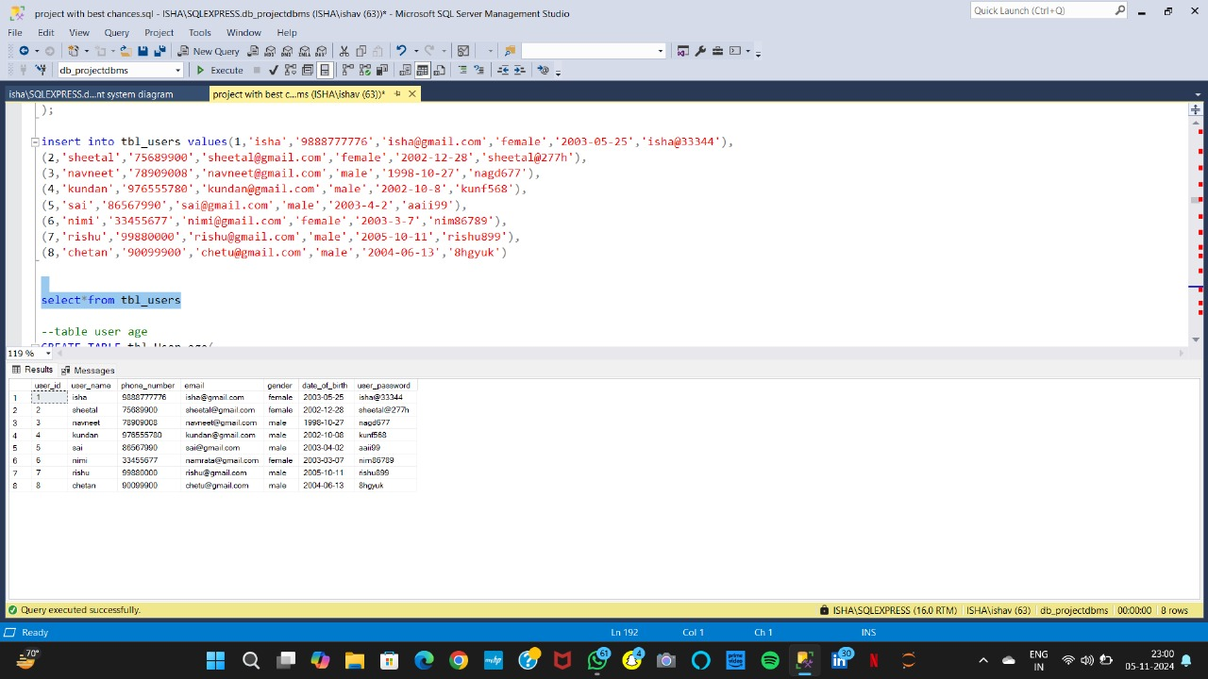
Insert Data:
----insert into tbl_users values(1,'isha','9888777776','isha@gmail.com','female','2003-05-25','isha@33344’),
(2,'sheetal','75689900','sheetal@gmail.com','female','2002-12-28','sheetal@277h’),
(3,'navneet','78909008','navneet@gmail.com','male','1998-10-27','nagd677’),
(4,'kundan','976555780','kundan@gmail.com','male','2002-10-8','kunf568’),
(5,'sai','86567990','sai@gmail.com','male','2003-4-2','aaii99’),
(6,'nimi','33455677','nimi@gmail.com','female','2003-3-7','nim86789’),
(7,'rishu','99880000','rishu@gmail.com','male','2005-10-11','rishu899’),
(8,'chetan','90099900','chetu@gmail.com','male','2004-06-13','8hgyuk’)

Slide 234
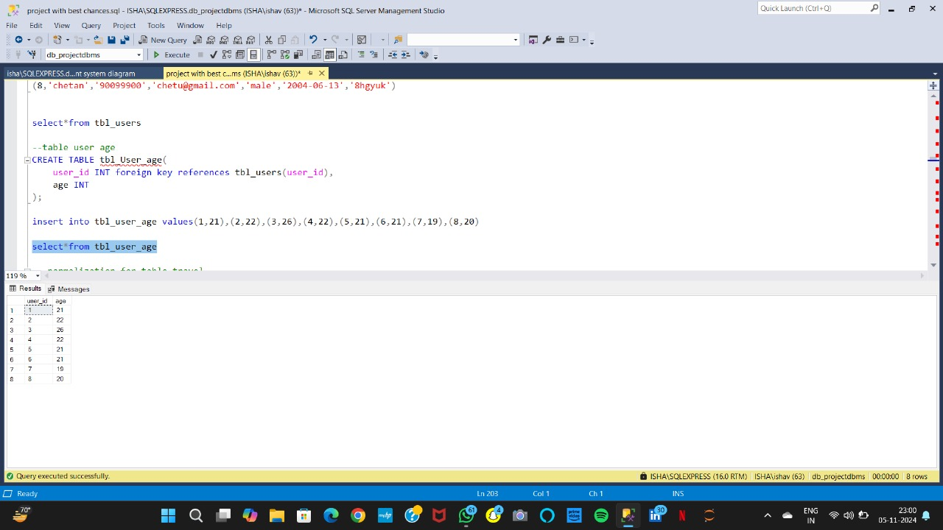
---insert into tbl_user_age values(1,21),(2,22),(3,26),(4,22),(5,21),(6,21),(7,19),(8,20)

Slide 235
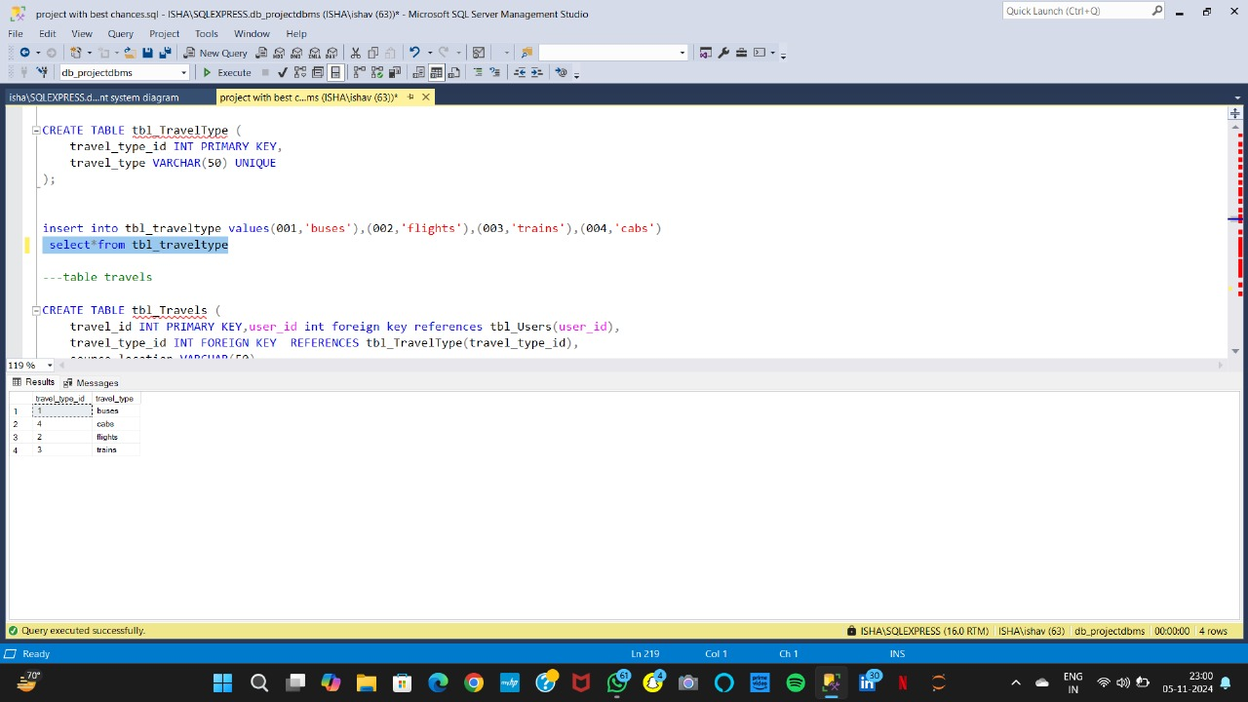
insert into tbl_traveltype values(001,'buses'),(002,'flights'),(003,'trains'),(004,'cabs')

Slide 236
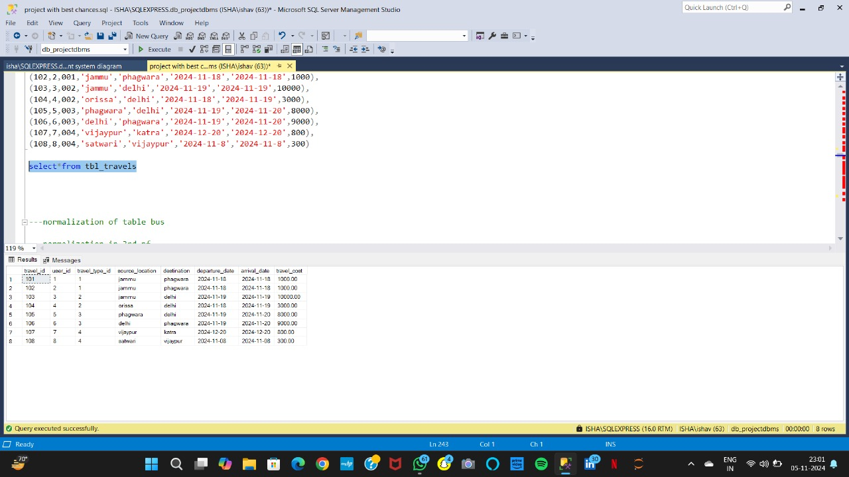
insert into tbl_travels values(101,1,001,'jammu','phagwara','2024-11-18','2024-11-18',1000),
(102,2,001,'jammu','phagwara','2024-11-18','2024-11-18',1000),
(103,3,002,'jammu','delhi','2024-11-19','2024-11-19',10000),
(104,4,002,'orissa','delhi','2024-11-18','2024-11-19',3000),
(105,5,003,'phagwara','delhi','2024-11-19','2024-11-20',8000),
(106,6,003,'delhi','phagwara','2024-11-19','2024-11-20',9000),
(107,7,004,'vijaypur','katra','2024-12-20','2024-12-20',800),
(108,8,004,'satwari','vijaypur','2024-11-8','2024-11-8',300)

Slide 237
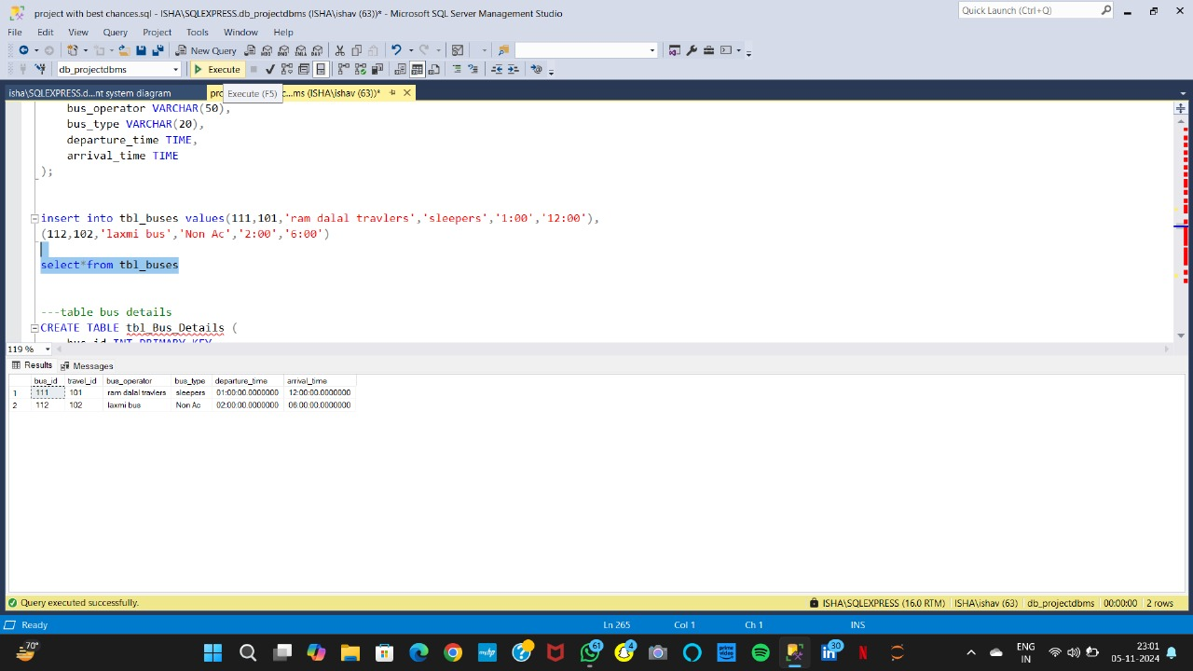
insert into tbl_buses values(111,101,'ram dalal travlers','sleepers','1:00','12:00’),
(112,102,'laxmi bus','Non Ac','2:00','6:00')

Slide 238
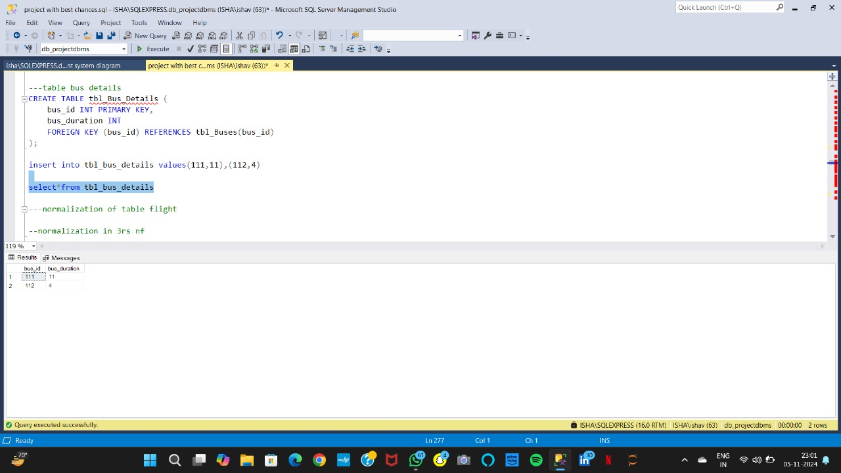
insert into tbl_bus_details values(111,11),(112,4)

Slide 239
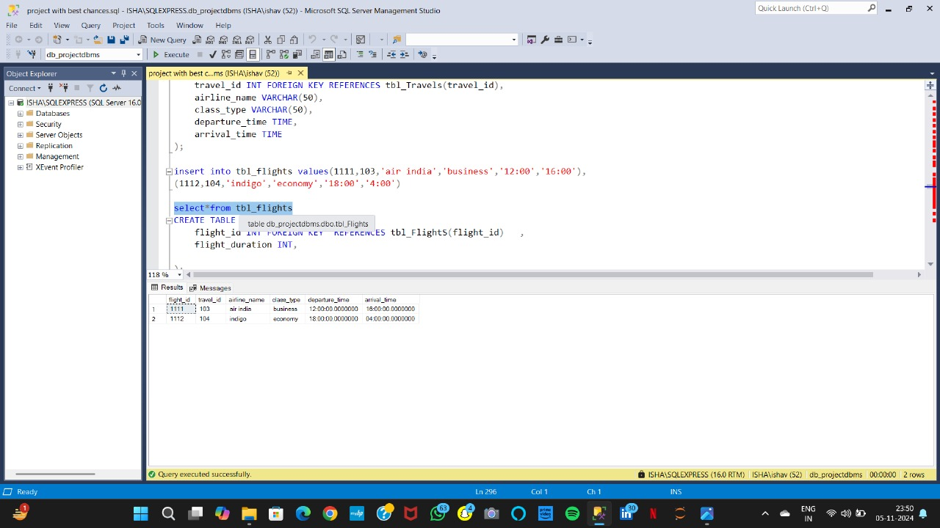
insert into tbl_flights values(1111,103,'air india','business','12:00','16:00’),
(1112,104,'indigo','economy','18:00','4:00')

Slide 240
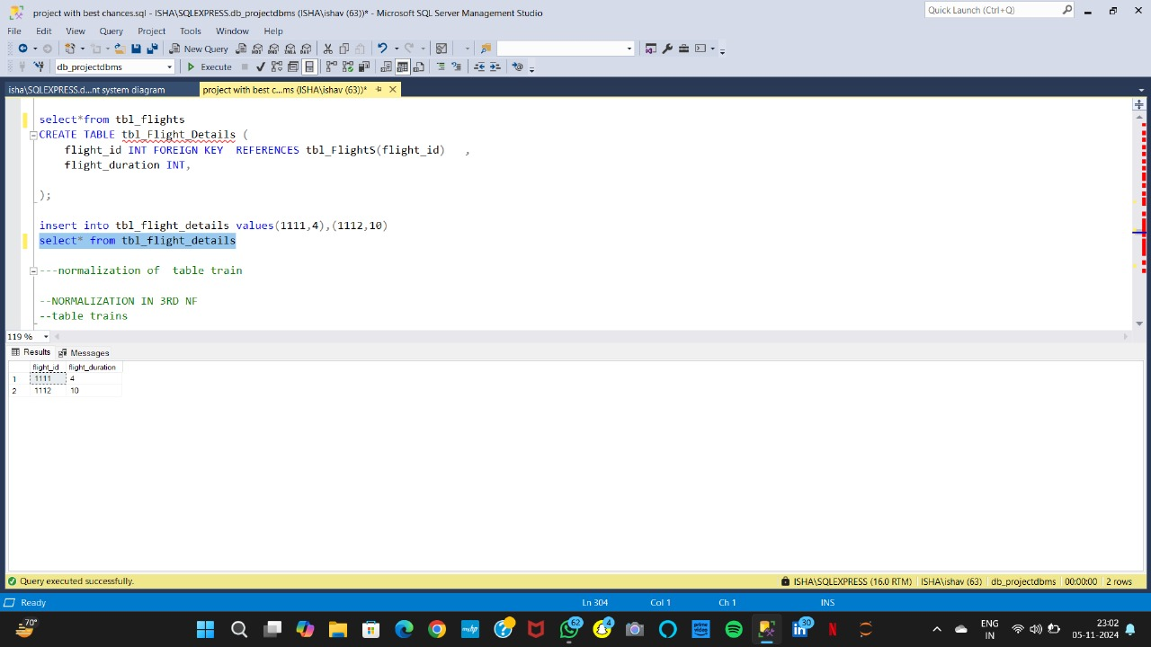
insert into tbl_flight_details values(1111,4),(1112,10)

Slide 241
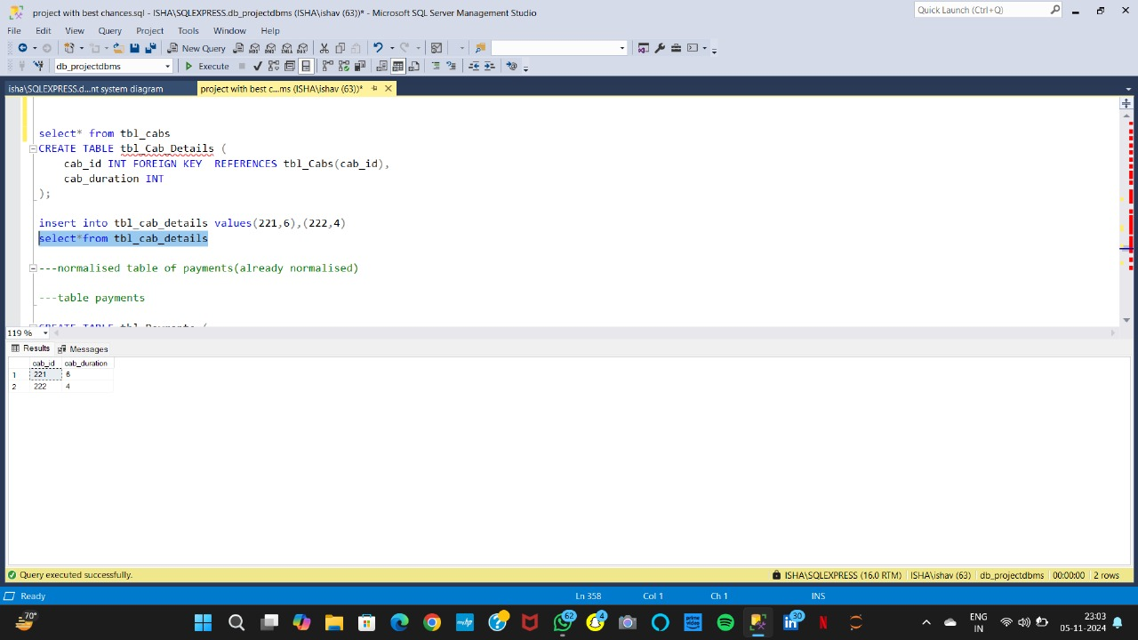
insert into tbl_cab_details values(221,6),(222,4)

Slide 242
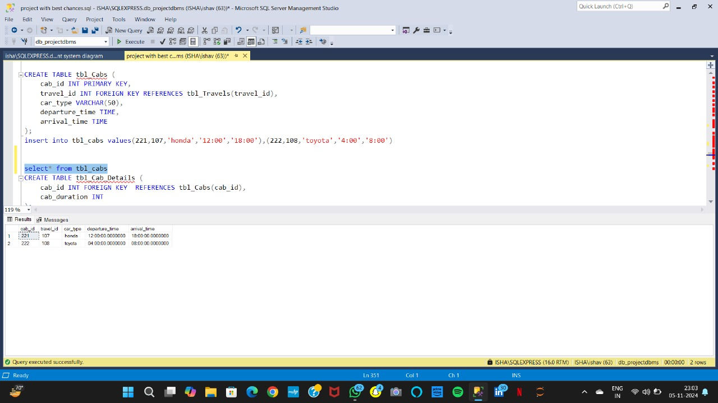
insert into tbl_cabs values(221,107,'honda','12:00','18:00’),
(222,108,'toyota','4:00','8:00')

Slide 243
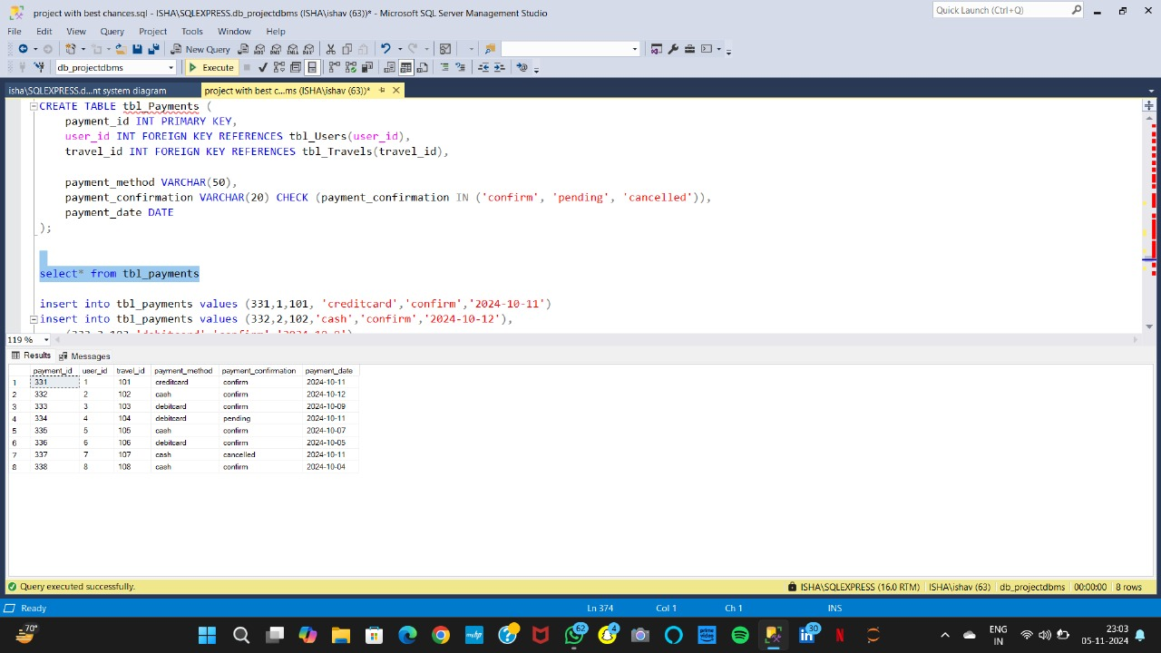
insert into tbl_payments values (331,1,101, 'creditcard','confirm','2024-10-11’),
insert into tbl_payments values (332,2,102,'cash','confirm','2024-10-12’),
(333,3,103,'debitcard','confirm','2024-10-9’),
(334,4,104,'debitcard','pending','2024-10-11’),
(335,5,105,'cash','confirm','2024-10-7’),
(336,6,106,'debitcard','confirm','2024-10-5’),
(337,7,107,'cash','cancelled','2024-10-11’),
(338,8,108,'cash','confirm','2024-10-4')

Slide 244
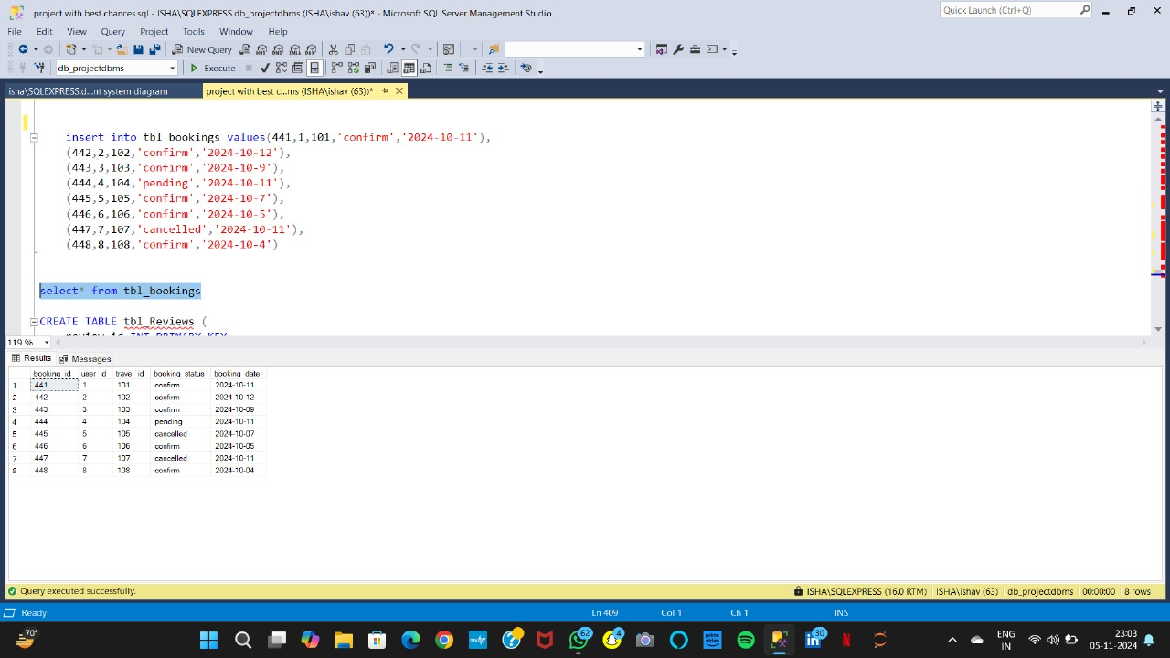
insert into tbl_bookings values(441,1,101,'confirm','2024-10-11’),
(442,2,102,'confirm','2024-10-12’),
(443,3,103,'confirm','2024-10-9’),
(444,4,104,'pending','2024-10-11’),
(445,5,105,'confirm','2024-10-7’),
(446,6,106,'confirm','2024-10-5’),
(447,7,107,'cancelled','2024-10-11’),
(448,8,108,'confirm','2024-10-4')

Slide 245
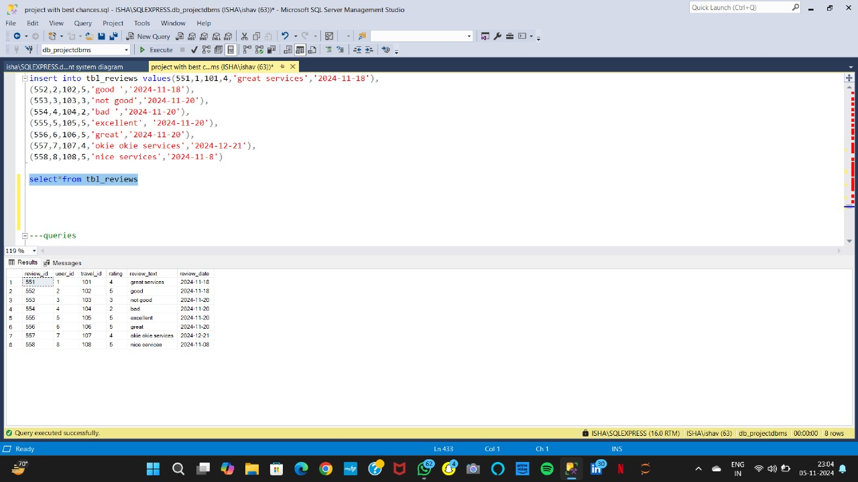
insert into tbl_reviews values(551,1,101,4,'great services','2024-11-18’),
(552,2,102,5,'good ','2024-11-18’),
(553,3,103,3,'not good','2024-11-20’),
(554,4,104,2,'bad ','2024-11-20’),
(555,5,105,5,'excellent', '2024-11-20’),
(556,6,106,5,'great','2024-11-20’),
(557,7,107,4,'okie okie services','2024-12-21’),
(558,8,108,5,'nice services','2024-11-8')

Slide 246
Queries:
Q.1 create table
CREATE TABLE tbl_Userss (
user_id INT PRIMARY KEY, user_name VARCHAR(100),
phone_number VARCHAR(15) UNIQUE,
email VARCHAR(60) UNIQUE,
gender CHAR(10),
date_of_birth Date ,
user_password VARCHAR(50)
);
Q.2: insert data into that table
Insert into tbl_user values(1,’anshi’,’987899903’,’anshi@gmail.com’,female’,’2010-10-22’,’387hjk’)
Question 3: display the content of table users :
Select* from tbl_userss

Slide 247
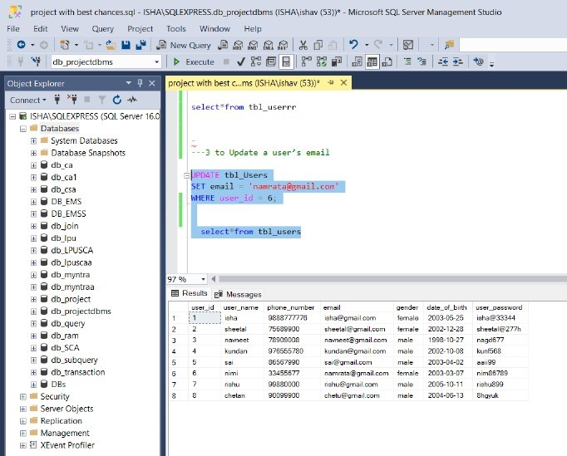
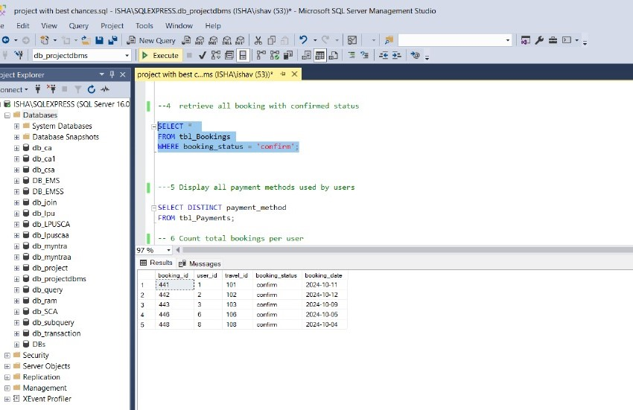
Queries
Q.4 Query to Update a user’s email ?
UPDATE tbl_Users
SET email = 'namrata@gmail.com’ WHERE user_id = 6;
select*from tbl_users
Q.5 Query to retrieve all booking with confirmed status?
SELECT * FROM tbl_Bookings
WHERE booking_status = 'confirm’;

Slide 248
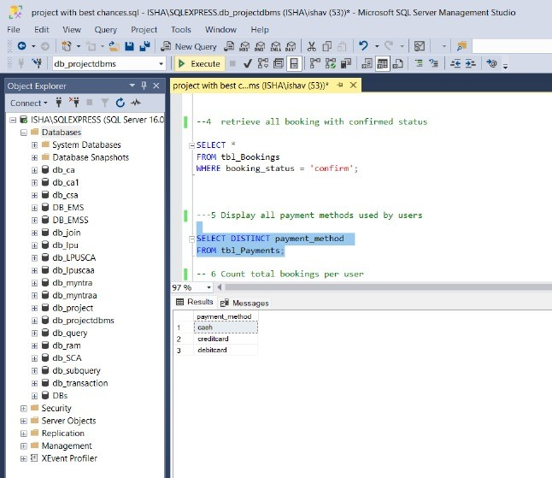
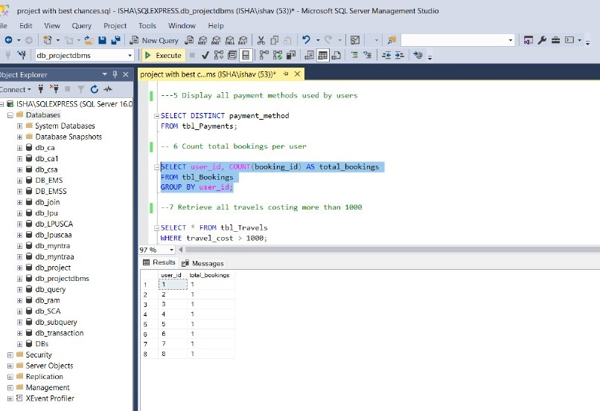
Q.6 Query to Display all payment methods used by users?
SELECT DISTINCT payment_method
FROM tbl_Payments;
Q.7 Query to Count total bookings per user?
SELECT user_id, COUNT(booking_id) AS total_bookings
FROM tbl_Bookings
GROUP BY user_id;

Slide 249
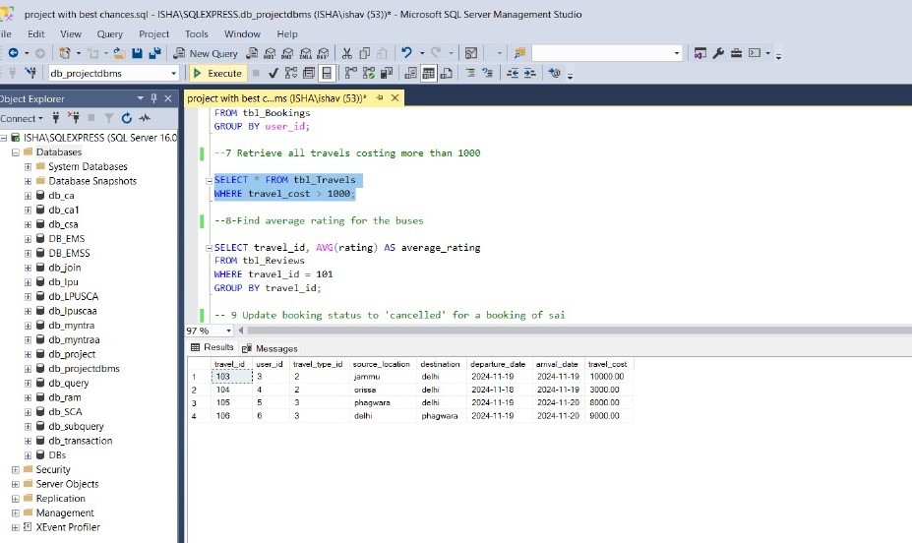
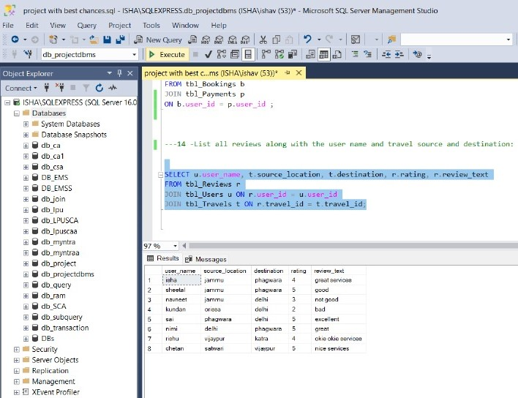
Q.8 Query to Retrieve all travels costing more than 1000?
SELECT * FROM tbl_Travels
WHERE travel_cost > 1000;
Q.9 Query to List all reviews along with the user name and travel source and destination?
SELECT u.user_name, t.source_location, t.destination, r.rating, r.review_text
FROM tbl_Reviews r
JOIN tbl_Users u ON r.user_id = u.user_id
JOIN tbl_Travels t ON r.travel_id = t.travel_id;

Slide 250
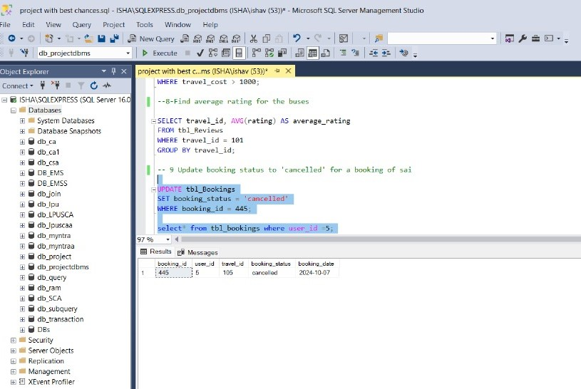
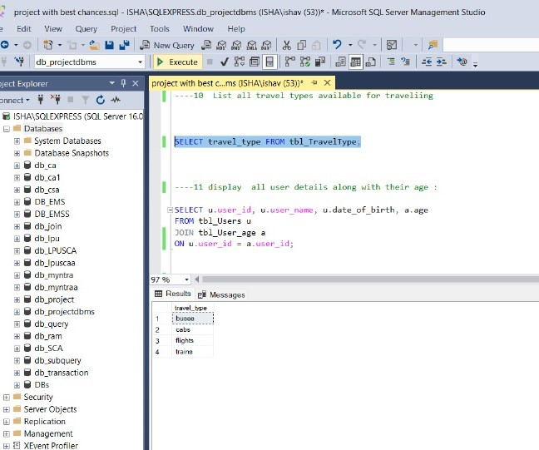
Q.10 Query to Update booking status to 'cancelled' for a booking of sai?
UPDATE tbl_Bookings
SET booking_status = 'cancelled’
WHERE booking_id = 445;
select* from tbl_bookings where user_id =5;
Q.11 Query to List all travel types available for traveling?
SELECT * FROM tbl_TravelType;

Slide 251
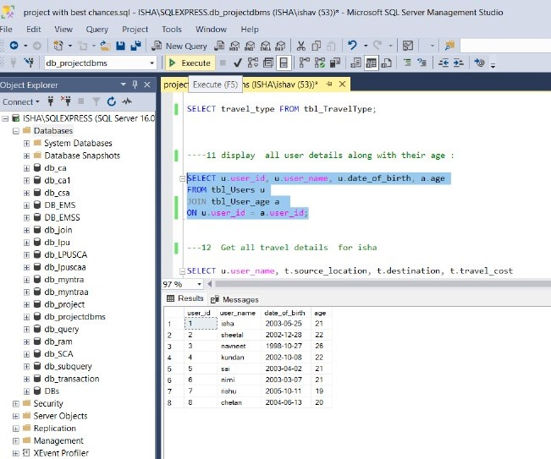
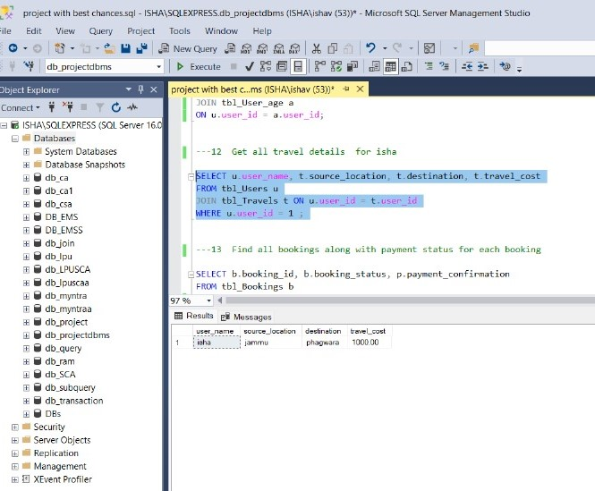
Q.12 Query to display all user details along with their age?
SELECT u.user_id, u.user_name, u.date_of_birth, a.age
FROM tbl_Users u
JOIN tbl_User_age a ON u.user_id = a.user_id;
Q.13 Query to Get all travel details for isha ?
SELECT u.user_name, t.source_location, t.destination, t.travel_cost
FROM tbl_Users u
JOIN tbl_Travels t ON u.user_id = t.user_id
WHERE u.user_id = 1 ;

Slide 252
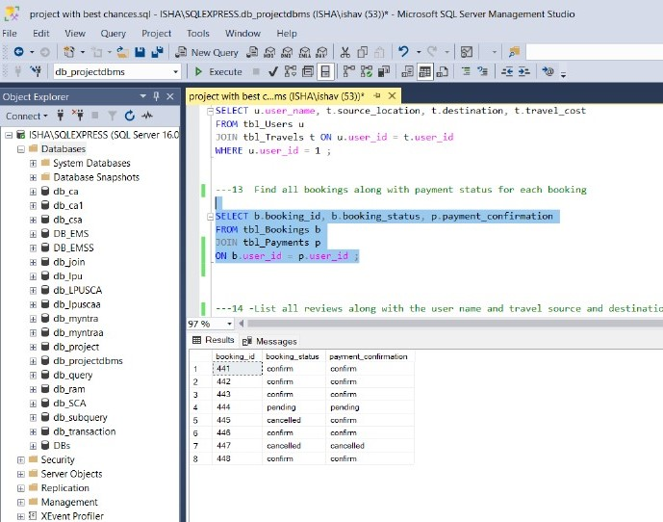
Q.14 Query to Find all bookings along with payment status for each booking?
SELECT b.booking_id, b.booking_status, p.payment_confirmation
FROM tbl_Bookings b
JOIN tbl_Payments p ON b.user_id = p.user_id

Slide 253
Conclusion
In conclusion, our Travel Management System efficiently streamlines travel planning by integrating essential entities like user, travel, train, bus, cabs, flights, payment, booking, and reviews. This system enables users to easily book various modes of transport, make secure payments, and provide feedback on their experience. It enhances user convenience by centralizing travel options, ensuring smooth coordination between different services. The review feature allows users to make informed choices based on others’ experiences, adding value and trust. Overall, this project simplifies travel arrangements, making it easier, faster, and more enjoyable for travelers.

